Slide 1

离散数学
Discrete Mathematics
钟芳明
离散数学
Discrete Mathematics

Slide 2

主讲教师
教育经历：
2008.09-2012.06，大连理工大学，软件工程，学士
2012.09-2014.06，大连理工大学，软件工程，硕士
2014.09-2018.09，大连理工大学，软件工程，博士
2016.09-2017.09，英国埃克塞特大学，国家公派联合培养
工作经历：
2018.10-2021.10 大连理工大学 博士后
（计算机科学与技术流动站-软件学院 ）
2021.10-今 大连理工大学 副教授 软件学院
研究方向：
跨模态检索、零样本学习、多模态数据融合表征

Slide 3
主讲教师 & 助教
钟芳明
 fmzhong@dlut.edu.cn
QQ：354082359
办公室：综合楼417
助教信息
曹 蕾
QQ：173596341
综合楼 4 楼研究生工作室

Slide 4
Evaluation
课 程 介 绍
课程考核方式
课程学习资料
课程参考教材
为什么是双语
什么是离散数学
课程学习内容
离散数学能干什么
课程学习目标
课程学习要求
学习小技巧
Routine performance 30%
Final exam 70%
Total 100%

Slide 5
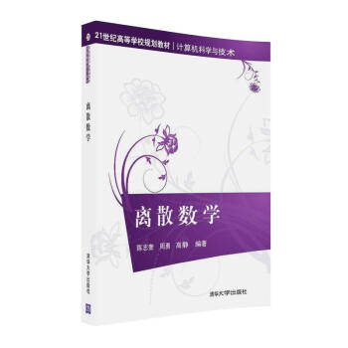
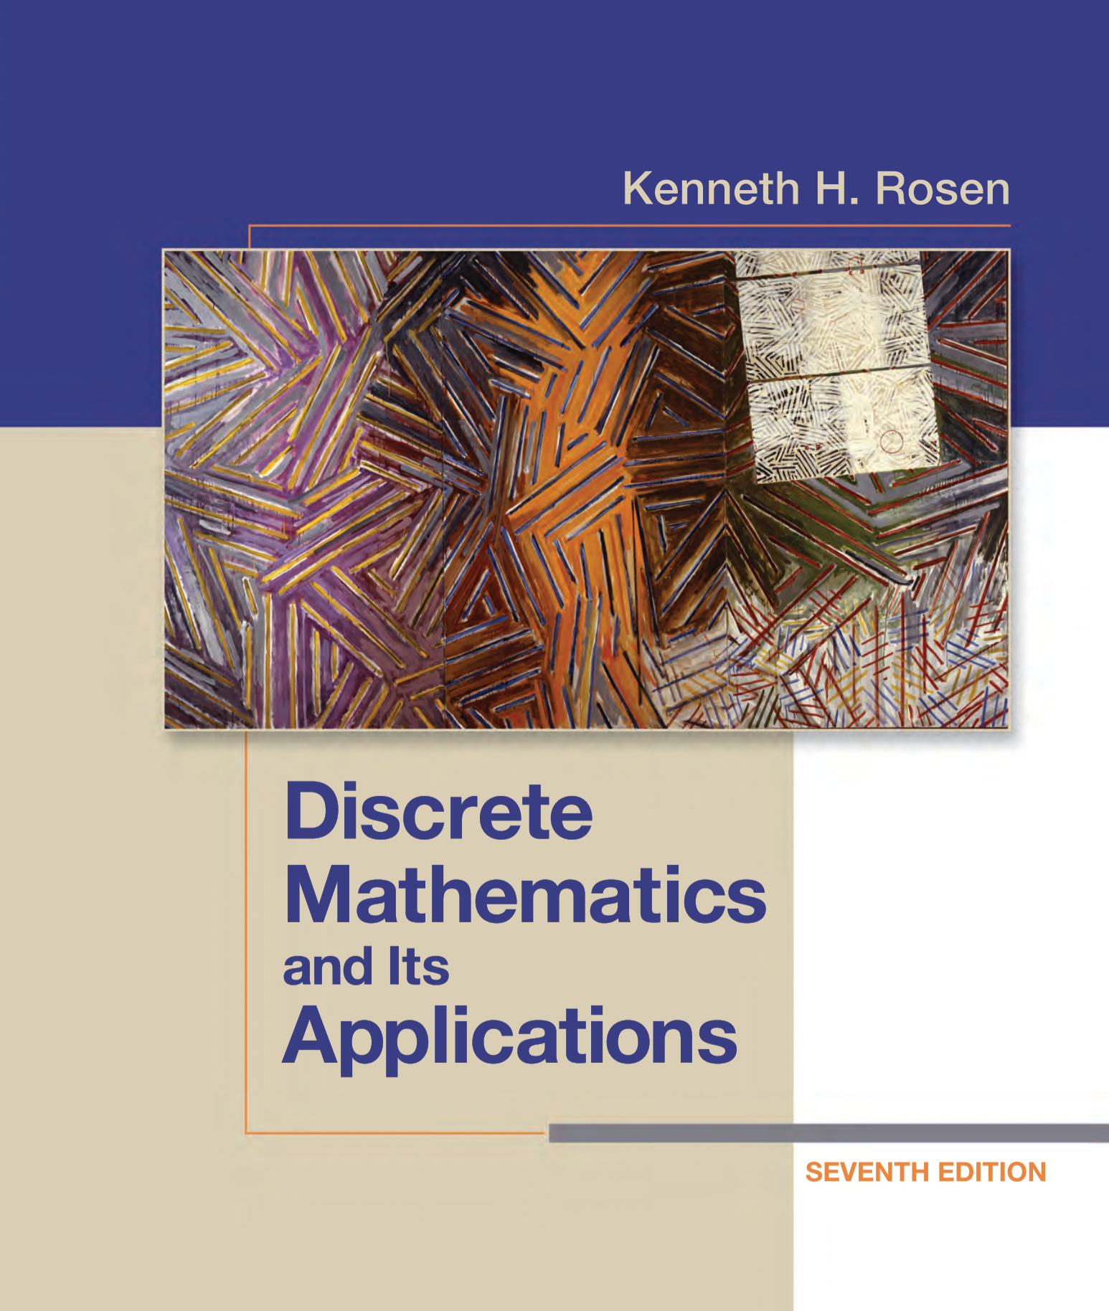
Textbook & References
课 程 介 绍
课程考核方式
课程参考教材
为什么是双语
什么是离散数学
课程学习内容
离散数学能干什么
课程学习目标
课程学习要求
学习小技巧
Textbook
《离散数学》陈志奎 周勇 高静 编著 清华大学出版社
Discrete Mathematics and Its Applications，7th Edition， Kenneth H. Rosen
Web Resource
http://www.ubinec.org/course/discrete-math.html
Slides and eBooks
References
DISCRETE MATHEMATICAL STRUCTURES （Fifth Edition), Bernard Kolman, Robert C.Busdy, Sharon Cutler Ross, 高等教育出版社
《离散数学与算法》曹晓东 原旭 编著 机械工业出版社
《离散数学》屈婉玲，耿素云，张立昂著 高等教育出版社

Slide 6
Why bilingual course?
课 程 介 绍
课程考核方式
课程参考教材
为什么是双语
什么是离散数学
课程学习内容
离散数学能干什么
课程学习目标
课程学习要求
学习小技巧
Origin of the modern science
English learning
Language foundation of further Mathematics Learning
Social needs

Slide 7

投票
最多可选1项
请回答选择离散数学双语课程的初衷：
A
未来打算出国深造
B
掌握数学英语，提高英语水平
C
尝尝鲜
D
不小心选错了o(╥﹏╥)o
提交

Slide 8
What is Discrete Mathematics?
课 程 介 绍
课程考核方式
课程参考教材
为什么是双语
什么是离散数学
课程学习内容
离散数学能干什么
课程学习目标
课程学习要求
学习小技巧
Discrete mathematics is the study of mathematical structures that are discrete rather than continuous.
Though discrete mathematics is described less by what is included than by what is excluded, the topics of Logic, Set Theory, Abstract Algebra and Graph Theory are always covered in any study regarding this matter.
It is widely applied in computer science and becomes a good tool for improving reasoning and problem-solving capabilities.

Slide 9
Course content
课 程 介 绍
课程考核方式
课程参考教材
为什么是双语
什么是离散数学
课程学习内容
离散数学能干什么
课程学习目标
课程学习要求
学习小技巧
Mathematical logic（数理逻辑）
Propositional logic（命题逻辑）
Predicate logic（谓词逻辑）
Set Theory（集合论）
Sets（集合）
Relations（关系）
Functions（函数）
Abstract Algebra（近似代数/抽象代数）
Graph Theory（图论）
Next semester

Slide 10
Why do we learn?
课 程 介 绍
课程考核方式
课程参考教材
为什么是双语
什么是离散数学
课程学习内容
离散数学能干什么
课程学习目标
课程学习要求
学习小技巧
How to prove a theorem automatically?
Does the largest infinity exist?
Why is it possible to encrypt and decrypt a text?
In coloring a map, how many colors are required so that the neighbor countries are marked in different colors?
Discrete mathematics is the gateway to more advanced courses in all parts of the mathematical sciences.
Discrete mathematics provides the mathematical foundations for many computer science courses including data structures, algorithms, database theory, automata theory, formal languages, compiler theory, computer security, and operating systems.

Slide 11
Goals
课 程 介 绍
课程考核方式
课程参考教材
为什么是双语
什么是离散数学
课程学习内容
离散数学能干什么
课程学习目标
课程学习要求
学习小技巧
Students should learn a particular set of mathematical facts and how to apply them;
More importantly, such a course should teach students how to think logically and mathematically
To cultivate reasoning and problem-solving capabilities in students.
To improve their reading and writing skills in academic English.
To enhance student’s vision in the globalized industry.

Slide 12
Requirements
课 程 介 绍
课程考核方式
课程参考教材
为什么是双语
什么是离散数学
课程学习内容
离散数学能干什么
课程学习目标
课程学习要求
学习小技巧
The course requires basic classroom discipline
Attending on time, do not be late and leave early
Participating into the questions of YUKETANG
Finish the homework on time
Work independently
Hand in your homework ON TIME (Every Wednesday) and Follow the information in QQ Groupe.
Writing requirements：
Well written, clear and typo-free
Indicate the name, student number and class number

Slide 13
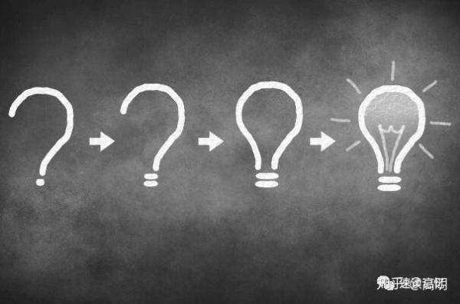

Learning Tips
课 程 介 绍
课程考核方式
课程参考教材
为什么是双语
什么是离散数学
课程学习内容
离散数学能干什么
课程学习目标
课程学习要求
学习小技巧
Grasp concepts and terms accurately；
Do more exercises and finish homework on time; Induce problem solving strategies;
Creative observation, diligent thinking and much more practicing.
Sort out knowledge points and summarize relevant relationships and rules
Collaboration, help each other, making friends.
Notes:
diligent thinking 勤奋思考

Slide 14
Chapter 1 Propositional Logic
1.1 Propositions and Connectives

Slide 15

What is logic？
命题逻辑
什么是逻辑
数理逻辑
逻辑的历史
命题
命题逻辑内容
什么是命题
逻辑联结词
逻辑联结词
非 析取
合取 异或
蕴含 双条件
命题翻译
Logic refers to the laws and rules of thinking and the abstraction of thinking process.
People observe, compare, analyze, synthesize, abstract, generalize, inference, and then understand the essence and law of things.
Logic is the basis of all mathematical reasoning, and of all automated reasoning.
It has practical applications to the design of computing machines, to the specification of systems, to artificial intelligence, to computer programming, to programming languages, and to other areas of computer science, as well as to many other fields of study.

Slide 16
Mathematical logic (数理逻辑)
命题逻辑
什么是逻辑
数理逻辑
逻辑的历史
命题
命题逻辑内容
什么是命题
逻辑联结词
逻辑联结词
非 析取
合取 异或
蕴含 双条件
命题翻译
Mathematical logic (数理逻辑)
Mathematical logic is a subfield of mathematics exploring the applications of formal logic to mathematics.
Treating the operations of formal logic in a symbolic or algebraic way.
Also called symbolic logic（符号逻辑）.
——from Wikipedia

Slide 17
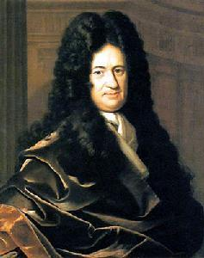
History of Logic
命题逻辑
什么是逻辑
数理逻辑
逻辑的历史
命题
命题逻辑内容
什么是命题
逻辑联结词
逻辑联结词
非 析取
合取 异或
蕴含 双条件
命题翻译
数理逻辑的创始人--莱布尼茨 (Leibniz, Gottfried Wilhelm) 1646.7.1-1716.11.14
The German rationalist philosopher, Gottfried Wilhelm Leibniz (1646-1716), is one of the great renaissance men of Western thought.
He has made significant contributions in several fields spanning the intellectual landscape, including mathematics, physics, logic, ethics, and theology.

Slide 18
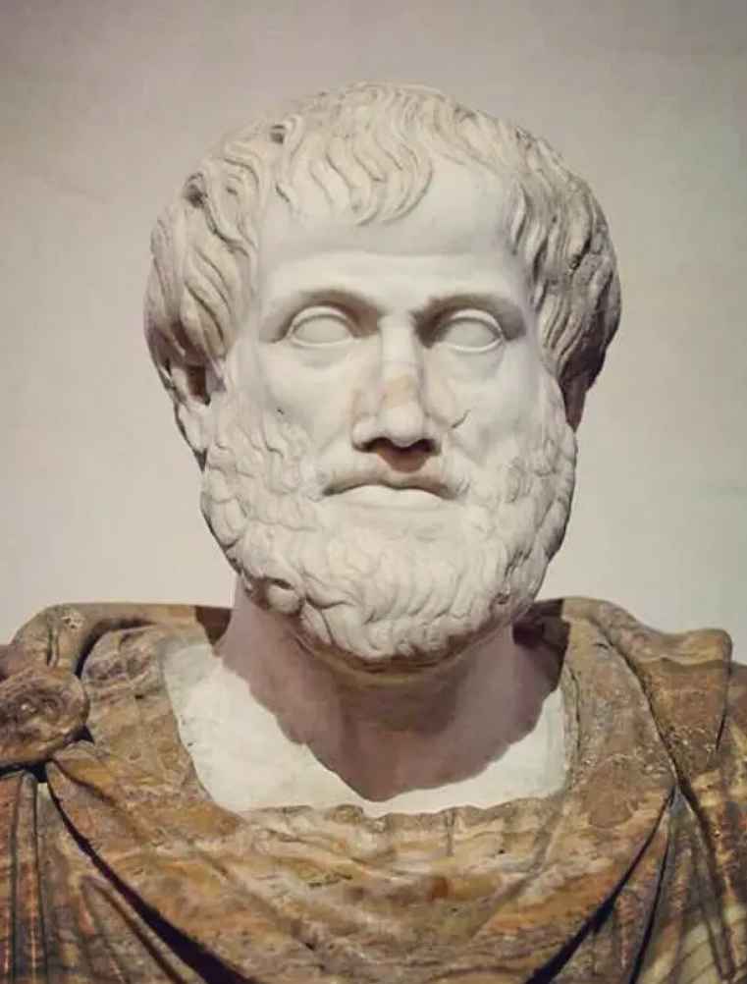
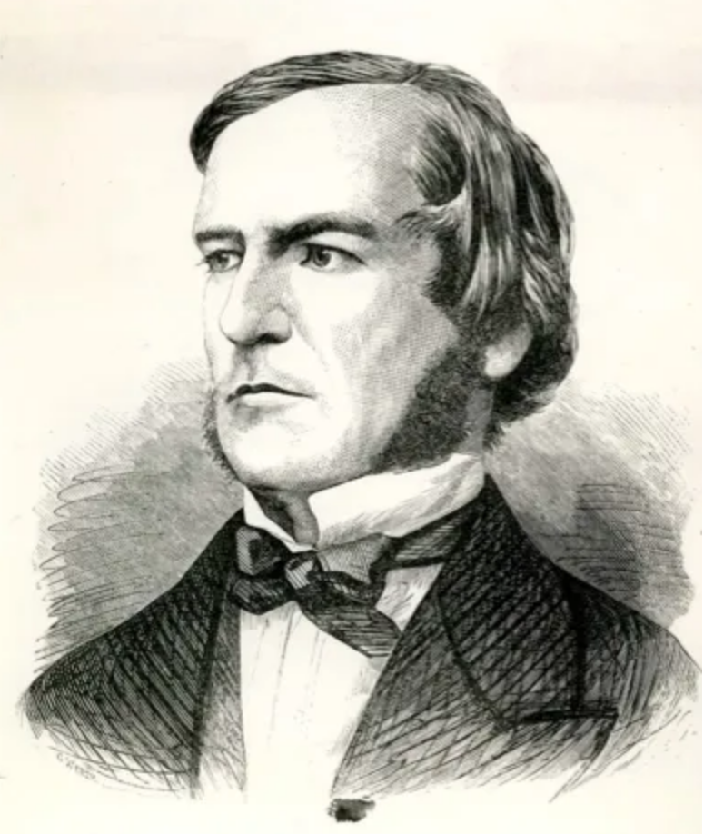
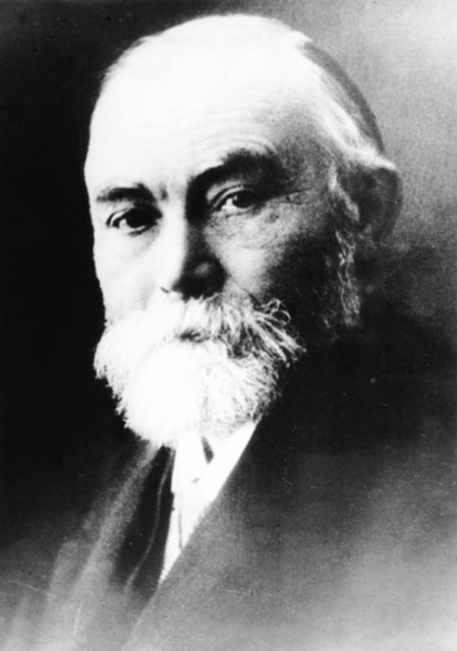
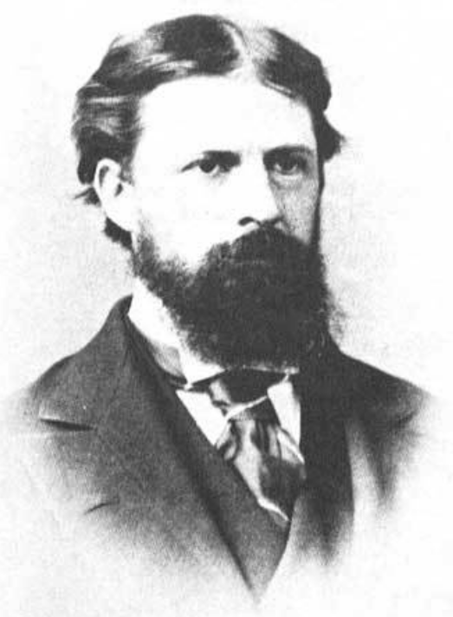
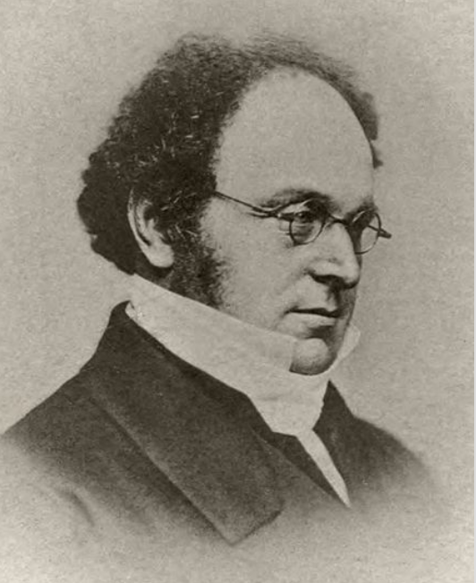
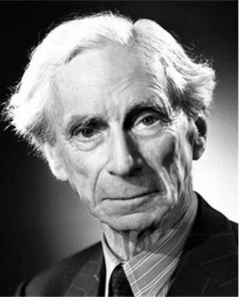
History of Logic
命题逻辑
什么是逻辑
数理逻辑
逻辑的历史
命题
命题逻辑内容
什么是命题
逻辑联结词
逻辑联结词
非 析取
合取 异或
蕴含 双条件
命题翻译
Greek philosopher
Aristotle
2300 years ago
Logic
German philosopher
Leibniz
New Logic Theory
17th century
English mathematician
George Boole
The Mathematical Analysis of Logic (In 1847)
German mathematician Gottlob Frege
Fundamentals of arithmetic
In 1884
Mathematical Logic
American
Charles Peirce
English mathematician
Augustus de Morgan
English mathematician
Russell

Slide 19
Mathematical logic (数理逻辑)
命题逻辑
什么是逻辑
数理逻辑
逻辑的历史
命题
命题逻辑内容
什么是命题
逻辑联结词
逻辑联结词
非 析取
合取 异或
蕴含 双条件
命题翻译
Main Research
Contents
Propositional logic
Predicate logic

Slide 20
Propositional Logic（命题逻辑）
命题逻辑
什么是逻辑
数理逻辑
逻辑的历史
命题
命题逻辑内容
什么是命题
逻辑联结词
逻辑联结词
非 析取
合取 异或
蕴含 双条件
命题翻译
Contents
Propositions and logical connectives
Propositional variable and compound formula
Tautology, tautological implication and identity
Bring-in rule and replace rule
Duality principle
Paradigm and its determination
Reasoning of propositional calculus

Slide 21
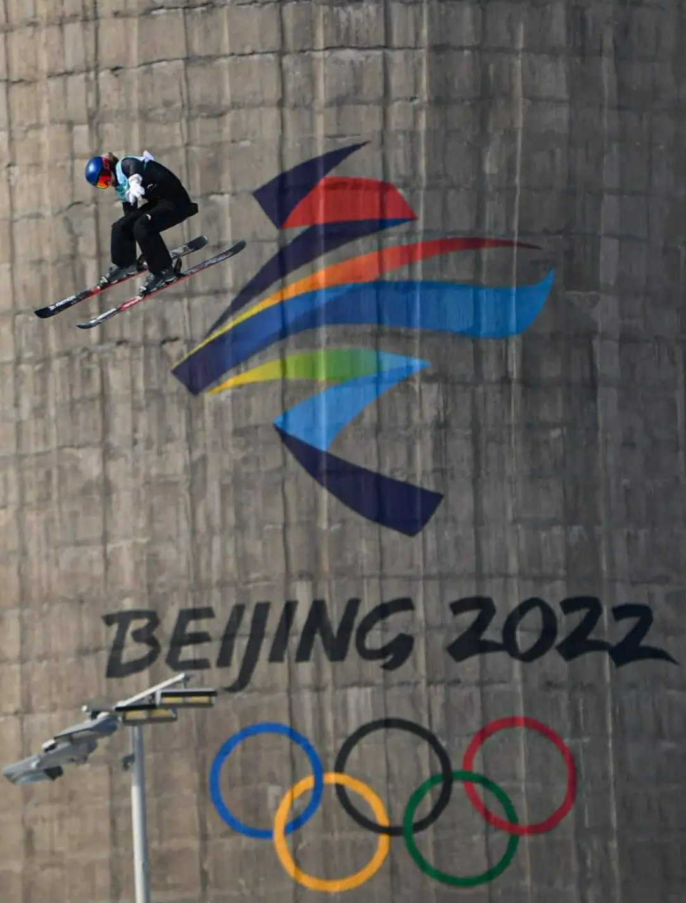
Propositions（命题）
命题逻辑
什么是逻辑
数理逻辑
逻辑的历史
命题
命题逻辑内容
什么是命题
逻辑联结词
逻辑联结词
非 析取
合取 异或
蕴含 双条件
命题翻译
The basic building blocks of logic—propositions
A proposition is a declarative sentence that is either true or false, but not both.
(not a question, command, imperative sentence etc.)
Example
Which are the propositions?
Beijing is the host city of the winter Olympics 2022.
Toronto is the capital of Canada.
1+101=110
What time is it?
x+1=3
x+y=z
Read the book carefully.
Notes:
that is, a sentence that declares a fact
Ottawa

Slide 22

Propositions
命题逻辑
什么是逻辑
数理逻辑
逻辑的历史
命题
命题逻辑内容
什么是命题
逻辑联结词
逻辑联结词
非 析取
合取 异或
蕴含 双条件
命题翻译
Barber paradox（悖论）:
The barber cuts hair for everyone who doesn't cut his own hair
Analysis：
（1）The barber cut his own hair.
（2）The barber does not cut his own hair.
The barber does not cut his own hair.
The barber need to cut his own hair.
Notes:
理发师打出一个广告：给所有不给自己剪发的人理发；
当有一天，理发师照镜子的时候，发现自己的头发长长了，他拿起剪刀剪还是不剪呢？

Slide 23
Propositions
命题逻辑
什么是逻辑
数理逻辑
逻辑的历史
命题
命题逻辑内容
什么是命题
逻辑联结词
逻辑联结词
非 析取
合取 异或
蕴含 双条件
命题翻译
The truth value (真值) and representation of a proposition
Propositions are written in capital English letters, for example P, Q, R ….
P：Today is Tuesday.
Propositions have only two possible truth values—True or False.
If the truth value of a proposition is true, it is denoted as 1 or T (Ture)；
If the truth value of a proposition is false, it is denoted as 0 or F (False).
A proposition, which cannot be decomposed into a simpler proposition, is called an atomic proposition (原子命题).

Slide 24


Compound Propositions
命题逻辑
什么是逻辑
数理逻辑
逻辑的历史
命题
命题逻辑内容
什么是命题
逻辑联结词
逻辑联结词
非 析取
合取 异或
蕴含 双条件
命题翻译
Atomic Proposition
Propositions
Molecule/Compound
Proposition (分子/复合命题)
？
If it snows next Sunday, then I‘ll go skiing.
If it doesn't rain next Sunday and there are no exams, I'll go to the beach.
Ming Zhao or Qiang Zhang in our class will attend this speech contest.

Slide 25
Connectives （联结词）
命题逻辑
什么是逻辑
数理逻辑
逻辑的历史
命题
命题逻辑内容
什么是命题
逻辑联结词
逻辑联结词
非 析取
合取 异或
蕴含 双条件
命题翻译
If P and Q are propositions, new compound propositions can be formed by using logic operators, also called connectives.
Most common connectives:
Negation (否定) NOT ¬
Conjunction (合取) AND ∧
Disjunction (析取) OR ∨
Exclusive disjunction (异或) Exclusive OR ∇
Implication(蕴含) (Conditional Statement) →
Double implication (等值) (Biconditional) ↔

Slide 26
Negation (否定) — ¬
命题逻辑
什么是逻辑
数理逻辑
逻辑的历史
命题
命题逻辑内容
什么是命题
逻辑联结词
逻辑联结词
非 析取
合取 异或
蕴含 双条件
命题翻译
Let P be a proposition. The negation of P, denoted by ¬P , is the statement “It is not the case that P.”
The proposition ¬P is read “not p.” The truth value of the negation of P, ¬P, is the opposite of the truth value of P.
Example
1. Find the negation of the statement “all prime Numbers are odd”.
SOLN:
“Not all prime Numbers are odd.”
“All prime Numbers are not odd.”
Negation of the whole, not of the part
2. Find the negation of the proposition “Michael’s PC runs Linux”
SOLN:
“It is not the case that Michael’s PC runs Linux.”
“Michael’s PC does not run Linux.”

Slide 27
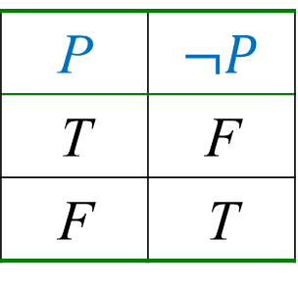
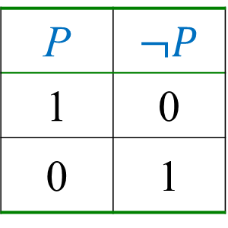
Negation (否定) — ¬
命题逻辑
什么是逻辑
数理逻辑
逻辑的历史
命题
命题逻辑内容
什么是命题
逻辑联结词
逻辑联结词
非 析取
合取 异或
蕴含 双条件
命题翻译
Truth table (真值表): using all possible combinations of the truth values of the operational object to determine the true or false of a proposition
P
T | F
F | T
P
1 | 0
0 | 1
or

Slide 28
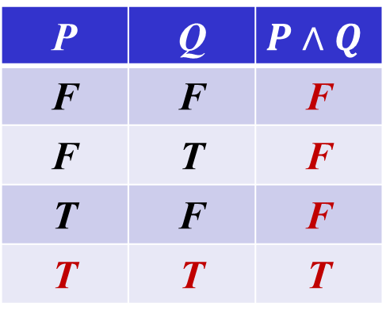
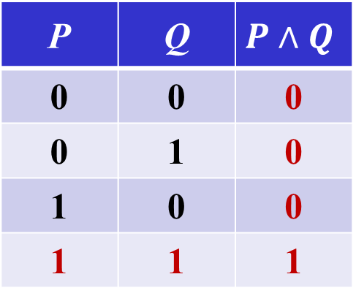
Conjunction (合取) —∧
命题逻辑
什么是逻辑
数理逻辑
逻辑的历史
命题
命题逻辑内容
什么是命题
逻辑联结词
逻辑联结词
非 析取
合取 异或
蕴含 双条件
命题翻译
Let P and Q be propositions. The conjunction of P and Q, denoted by P∧Q, is the proposition “P and Q.” The conjunction P∧Q is true when both P and Q are true and is false otherwise.
Truth table
P | Q
F | F | F
F | T | F
T | F | F
T | T | T
P | Q
0 | 0 | 0
0 | 1 | 0
1 | 0 | 0
1 | 1 | 1
or

Slide 29
Conjunction (合取) —∧
命题逻辑
什么是逻辑
数理逻辑
逻辑的历史
命题
命题逻辑内容
什么是命题
逻辑联结词
逻辑联结词
非 析取
合取 异或
蕴含 双条件
命题翻译
Example
1. Find the conjunction of the propositions P and Q, where
P: Today is Monday.
Q: Today is raining.
SOLN:
Today is Monday and it is raining.
For this conjunction to be true, both conditions given must be true. It is false, when one or both of these conditions are false.
2. Find the conjunction of the propositions P and Q, where
P: Beijing is the host city of winter Olympics 2022.
Q: Beijing is the host city of summer Olympics 2008.
SOLN:
Beijing is the host city of winter Olympics 2022, and it’s also the host city of summer Olympics 2008

Slide 30
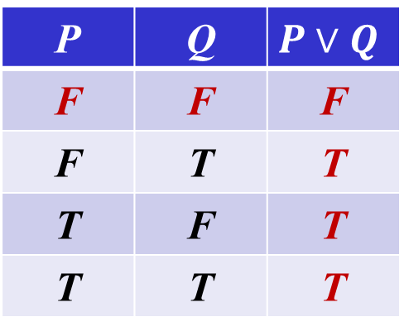
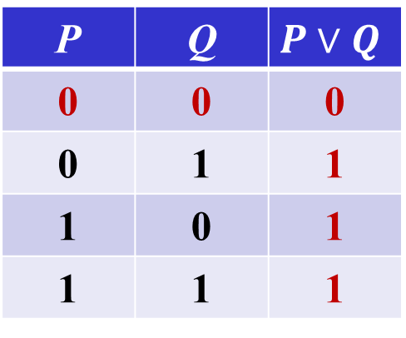
Disjunction (析取) —∨
命题逻辑
什么是逻辑
数理逻辑
逻辑的历史
命题
命题逻辑内容
什么是命题
逻辑联结词
逻辑联结词
非 析取
合取 异或
蕴含 双条件
命题翻译
Let P and Q be propositions. The disjunction of P and Q, denoted by P ∨ Q, is the proposition “P or Q.” The disjunction P ∨ Q is false when both P and Q are false and is true otherwise. (Inclusive OR)
P | Q
F | F | F
F | T | T
T | F | T
T | T | T
P | Q
0 | 0 | 0
0 | 1 | 1
1 | 0 | 1
1 | 1 | 1
or
Notes:
Inclusive Disjunction

Slide 31
Disjunction (析取) ——∨
命题逻辑
什么是逻辑
数理逻辑
逻辑的历史
命题
命题逻辑内容
什么是命题
逻辑联结词
逻辑联结词
非 析取
合取 异或
蕴含 双条件
命题翻译
Example
P： Ming Li is at the classroom.
Q： Qiang Zhang is a good coach.
Find the disjunction of P and Q.
Solution:
P ∨ Q is the statement that “Ming Li is at the classroom or Qiang Zhang is a good coach”.
P： Ming Li is at the classroom.
Q： Ming Li is at the tennis court.
How to represent “Ming Li is at the class room or tennis court”?
Inclusive OR
exclusive OR

Slide 32
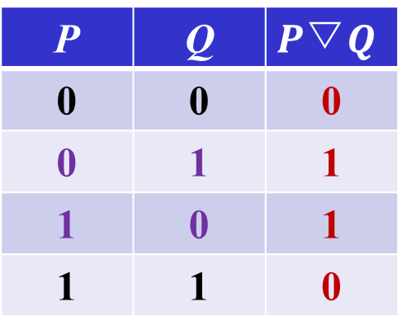
Exclusive disjunction (异或) —▽
命题逻辑
什么是逻辑
数理逻辑
逻辑的历史
命题
命题逻辑内容
什么是命题
逻辑联结词
逻辑联结词
非 析取
合取 异或
蕴含 双条件
命题翻译
The exclusive disjunction of propositions P and Q is denoted by P▽Q . When exactly one value of P and Q is true, P▽Q is true， otherwise it is false.
Example: real number a is either rational or irrational.
P | Q | P ▽Q
F | F | F
F | T | T
T | F | T
T | T | F
P | Q
0 | 0 | 0
0 | 1 | 1
1 | 0 | 1
1 | 1 | 0
or

Slide 33
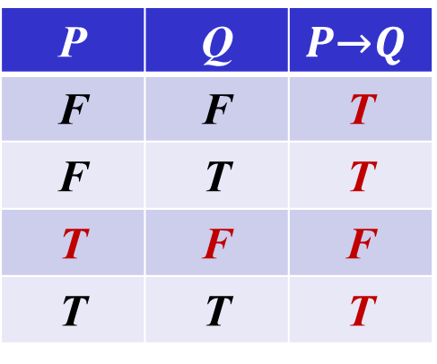
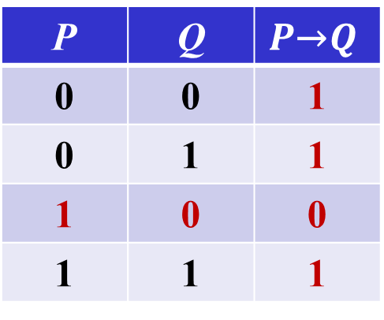
Conditional Statement — →
命题逻辑
什么是逻辑
数理逻辑
逻辑的历史
命题
命题逻辑内容
什么是命题
逻辑联结词
逻辑联结词
非 析取
合取 异或
蕴含 双条件
命题翻译
Let P and Q be propositions. The conditional statement P → Q, is the proposition “if P, then Q.” The conditional statement of P → Q is false when P is true and Q is false, and true otherwise. In the conditional statement P → Q , P is called the hypothesis (or antecedent or premise), and Q is called the conclusion (or consequence). (Implication, 蕴含)
P | Q
F | F | T
F | T | T
T | F | F
T | T | T
P | Q
0 | 0 | 1
0 | 1 | 1
1 | 0 | 0
1 | 1 | 1
or

Slide 34
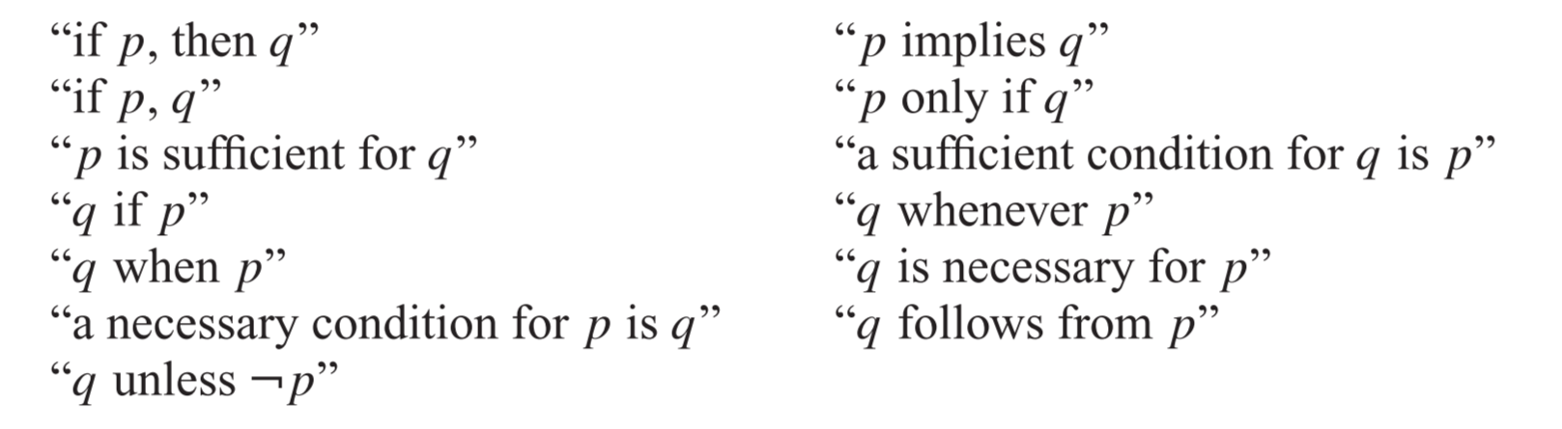
Conditional Statement — →
命题逻辑
什么是逻辑
数理逻辑
逻辑的历史
命题
命题逻辑内容
什么是命题
逻辑联结词
逻辑联结词
非 析取
合取 异或
蕴含 双条件
命题翻译
Q unless ¬P
除非 Q，才 P
P only if Q ，
只有 Q，才 P
Notes:
Unless ，如果不

Slide 35
Conditional Statement — →
命题逻辑
什么是逻辑
数理逻辑
逻辑的历史
命题
命题逻辑内容
什么是命题
逻辑联结词
逻辑联结词
非 析取
合取 异或
蕴含 双条件
命题翻译
Example
Politicians campaign with promises
"If I am elected, then I'm going to lower taxes."
P： I'm elected
Q： I'm going to lower taxes
Formalized as ： P → Q
If today is Friday, then 2+2=4.
P： today is Friday
Q： 2+2=4
Formalized as ： P → Q
Meaningless language in the real world can also be translated

Slide 36
Conditional Statement — →
命题逻辑
什么是逻辑
数理逻辑
逻辑的历史
命题
命题逻辑内容
什么是命题
逻辑联结词
逻辑联结词
非 析取
合取 异或
蕴含 双条件
命题翻译
In daily life, the conditional expression refers to the causal or substantive relationship between the premises and the conclusion. This condition is called a formal condition proposition (形式条件命题) .
In propositional logic, however, a conditional premise is not required to have anything to do with the conclusion. This condition is called a substantive condition proposition (实质条件命题).
Propositional Language VS Natural Language
Independent of a cause-and-effect relationship
Notes:
英ˈkɔːz(ə)l

Slide 37
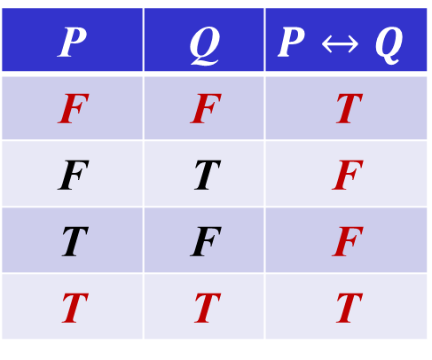
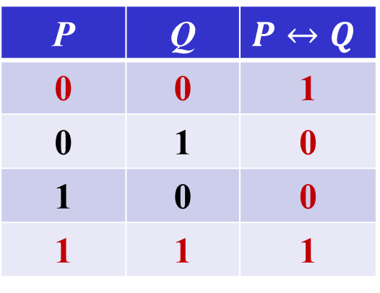
Biconditional Statement — ↔
命题逻辑
什么是逻辑
数理逻辑
逻辑的历史
命题
命题逻辑内容
什么是命题
逻辑联结词
逻辑联结词
非 析取
合取 异或
蕴含 双条件
命题翻译
Let P and Q be propositions. The biconditional statement of P ↔ Q, is the proposition “P if and only if Q.” The biconditional statement of P ↔ Q is true when both P and Q have the same truth values, and is false otherwise. Biconditional statements are also called bi-implications.
P | Q
F | F | T
F | T | F
T | F | F
T | T | T
P | Q
0 | 0 | 1
0 | 1 | 0
1 | 0 | 0
1 | 1 | 1
or
Notes:
—(Double Bi-implication or equivalence)
⇋ ⇌ ↔ ↕ ⇄ ⇅ ⇆ ⇔

Slide 38
Biconditional Statement — ↔
命题逻辑
什么是逻辑
数理逻辑
逻辑的历史
命题
命题逻辑内容
什么是命题
逻辑联结词
逻辑联结词
非 析取
合取 异或
蕴含 双条件
命题翻译
Example
Let P be the statement “You can take the flight,” and let Q be the statement “You buy a ticket.”
Then P ↔ Q is the statement，
“You can take the flight if and only if you buy a ticket.”
Notes:
—(Double Bi-implication or equivalence)
⇋ ⇌ ↔ ↕ ⇄ ⇅ ⇆ ⇔

Slide 39
Precedence
命题逻辑
什么是逻辑
数理逻辑
逻辑的历史
命题
命题逻辑内容
什么是命题
逻辑联结词
逻辑联结词
非 析取
合取 异或
蕴含 双条件
命题翻译
Precedence（优先级）：
¬ ∧ ∨ → ↔
P ∨ Q ∧ R
(P ∨ Q ) ∧ R

Slide 40
Translation
命题逻辑
什么是逻辑
数理逻辑
逻辑的历史
命题
命题逻辑内容
什么是命题
逻辑联结词
逻辑联结词
非 析取
合取 异或
蕴含 双条件
命题翻译
Translation from sentence to logical expression
Steps：
Determine whether a given sentence is a proposition；
Find out the atomic propositions and determine the conjunctions in sentences as the corresponding connectives；
Use correct grammar to represent the original proposition as a formula made up of atomic propositions, connectives and parentheses（括号）.

Slide 41
Translation
命题逻辑
什么是逻辑
数理逻辑
逻辑的历史
命题
命题逻辑内容
什么是命题
逻辑联结词
逻辑联结词
非 析取
合取 异或
蕴含 双条件
命题翻译
Example
Translate the following propositions：
(1) He is clever and diligent.
(2) He is clever but not diligent.
Solution：
Atomic proposition
P：He is clever.
Q：He is diligent.
so：
(1) P ∧ Q
(2) P ∧ ¬Q

Slide 42
Translation
命题逻辑
什么是逻辑
数理逻辑
逻辑的历史
命题
命题逻辑内容
什么是命题
逻辑联结词
逻辑联结词
非 析取
合取 异或
蕴含 双条件
命题翻译
Example
I will go to the cinema unless I have no time
A：I have no time.
B：I will go to the cinema.
Translated as ： ¬ A→ B
P→ Q , can be translated to “Q unless ¬ P”
I won't admit you're right unless the Sun rises in the west
A：I won’t admit you're right
B：The Sun rises in the west
Translated as ：¬B→ A
Notes:
连词。
①只有。表示唯一的条件：除非临时有事，我才不去。
②除了。表示不计算在内：除非临时有事，我一定去。

Slide 43
Translation
命题逻辑
什么是逻辑
数理逻辑
逻辑的历史
命题
命题逻辑内容
什么是命题
逻辑联结词
逻辑联结词
非 析取
合取 异或
蕴含 双条件
命题翻译
Example
If both you and he are not stubborn（固执已见）, then unpleasant things will not happen.
P：You are stubborn.
Q：He is stubborn.
R：Unpleasant things will not happen.
Translate into： (¬P∧¬Q)→R
If you and he are not both stubborn, then unpleasant things will not happen.
Translate into： ¬(P ∧ Q)→R

Slide 44
Translation
命题逻辑
什么是逻辑
数理逻辑
逻辑的历史
命题
命题逻辑内容
什么是命题
逻辑联结词
逻辑联结词
非 析取
合取 异或
蕴含 双条件
命题翻译
Example
You cannot ride the roller coaster if you are under 4 feet tall unless you are older than 16 years old.
P：You can ride the roller coaster 。
Q：You are under 4 feet tall.
R：You are older than 16 years old.
Translate into：
(Q ∧ ¬R ) → ¬ P
Of course, there are other ways to represent the original sentence as a logical expression, but the one we have used should meet our needs.
Notes:
过山车

Slide 45
Logic puzzles
命题逻辑
什么是逻辑
数理逻辑
逻辑的历史
命题
命题逻辑内容
什么是命题
逻辑联结词
逻辑联结词
非 析取
合取 异或
蕴含 双条件
命题翻译
An island is inhabited by two kinds of people – knights(骑士) and knaves（流氓）. Knights tell the truth, and knaves lie. You meet two people, A and B, If A says “B is a knight”, B says “we are not in the same class”. Please decide whether A and B are knaves or knights.
Solution：First, assume that P: A is a knight ；Q: B is a knight；
What A said ：Q，What B said ： (P ∧ ¬Q) ∨ (¬P ∧ Q)
P | Q | What A said ：Q | What B said : (P∧¬Q)∨(¬P∧Q)
0 | 0 | 0 | 0
0 | 1 | 1 | 1
1 | 0 | 0 | 1
1 | 1 | 1 | 0

Slide 46
Logic puzzles
命题逻辑
什么是逻辑
数理逻辑
逻辑的历史
命题
命题逻辑内容
什么是命题
逻辑联结词
逻辑联结词
非 析取
合取 异或
蕴含 双条件
命题翻译
Solution：Enumeration, there are only four possibilities.
Suppose they're all knights. B is lying. It's not true.
Suppose A is a knight and B is a knaves. A is lying. It's not true
Suppose A is a knaves and B is a knight. A telling the truth. it's not true.
Suppose A and B are both knaves. it's true.
So they are both knaves.
P | Q | A：Q | B: (P∧¬Q)∨(¬P∧Q)
0 | 0 | 0 | 0
0 | 1 | 1 | 1
1 | 0 | 0 | 1
1 | 1 | 1 | 0
A：¬Q
1
0
1
0

Slide 47
Translation
命题逻辑
什么是逻辑
数理逻辑
逻辑的历史
命题
命题逻辑内容
什么是命题
逻辑联结词
逻辑联结词
非 析取
合取 异或
蕴含 双条件
命题翻译
P: Grizzly bears have been seen in the area.
Q: Hiking is safe on the trail.
R: Berries are ripe along the trail.
Berries are ripe along the trail, but grizzly bears have not been seen in the area.
Grizzly bears have not been seen in the area and hiking on the trail is safe, but berries are ripe along the trail.
If berries are ripe along the trail, hiking is safe if and only if grizzly bears have not been seen in the area.
Notes:
Whenever 每当，

Slide 48
单选题
1分
P: Grizzly bears have been seen in the area.
Q: Hiking is safe on the trail.
R: Berries are ripe along the trail.
If berries are ripe along the trail, hiking is safe if and only if grizzly bears have not been seen in the area.
A
P → (Q ∧ R)
B
(Q ↔ R) → P
C
R→ (Q ↔ ¬P)
D
P → Q → R
提交

Slide 49
Translation
命题逻辑
什么是逻辑
数理逻辑
逻辑的历史
命题
命题逻辑内容
什么是命题
逻辑联结词
逻辑联结词
非 析取
合取 异或
蕴含 双条件
命题翻译
P: Grizzly bears have been seen in the area.
Q: Hiking is safe on the trail.
R: Berries are ripe along the trail.
It is not safe to hike on the trail, but grizzly bears have not been seen in the area and the berries along the trail are ripe.
For hiking on the trail to be safe, it is necessary but not sufficient that berries not be ripe along the trail and for grizzly bears not to have been seen in the area.
Hiking is not safe on the trail whenever grizzly bears have been seen in the area and berries are ripe along the trail.
Notes:
Whenever 每当，

Slide 50
Summarization
Tips
What is proposition
Connectives
Negation, NOT
Conjunction, AND
Disjunction, Inclusive OR
Exclusive Disjunction, Exclusive OR
Conditional Statements, Implication
Biconditional Statements, Bi-implication
Precedence

Slide 51
Homework
Exercises in Chapter 1
1, 2，3
4（1）、（3）
6（2）、（4）
9

Slide 52
Up Next …
Propositions
Compound Formula
Truth Table
Tautology
Logical Equivalences

Slide 53

The End
Thanks

